Slide 1
welcome

Slide 2
Project Title: Library Management system
Team <>Argo

Slide 3
team member :
1. Abir Hasan-13101087
2. Ali Hasan-13101089
Project ID-01

Slide 4

Contents:
Introduction
Project description
Project features
Project efficiency
Project lacking's
Usage
Flow chart
Project demo
Future motivation
Graphics

Slide 5
Introduction
There are two projects in our group, one is ‘Library Management System’ and another is ‘Graphics’ project. Both are based on c language. Briefly, ‘Library Management System’ provides us online book borrowing and submitting facilities. In ‘Graphics’ we can show dynamic round of ‘Library Management System’ with many zigzag color view.

Slide 6
Project description

Slide 7
Cont...
In Teachnical feacibility-
We mainly used C language with very high use of very well known some header File .
Our project specially based on-
1.File System
2.Data Structure
3.String,etc.

Slide 8
Project feature
Book ID
Book Name
Author Name
Publisher Name
Book Category
Borrower
ID
Book in Stock

Slide 9
Project feature cont.
1.Storing Various Books Data which are Present in The Library.
2.Showcase of Organized Book.
3.User Friendly.
4.User Efficient.
5.Time Efficient.
6.Re-Ordering Facility
7.Borrowing and Submitting Recorder.
8.Analysed On Various Book in Short Time Period.

Slide 10
Project lacking’s
Although our program is user efficient but as like others we also facing some lacking's .
But we are pretty sure we will get rid out of it very Soon.
In the mean time we will upgrade more features in it.

Slide 11
usage
Any Educational Institute
Any Public Libary
Book Store
Book Fair DB
And Many Other Institute which used to with Books

Slide 12
flow chart
Feature menu
Choose from the Manu
Borrow
Submit
Category
Entering borrower id
Choose from the Manu
Check for borrower

Slide 13
Cont...
Show book list H;
Count++;
Choosing book
goto H;
Save file
Input ID
Count--;
Save file;
Exit;

Slide 14
project demo
#include<stdio.h>
#include<stdlib.h>
#include<string.h>
struct info
{
char book_name[100];
char author[100];
char publisher[100];
int book_id;
int stock;
} s[10];
int main()
{ printf("\t____LMS by Team'ARGO'____\\n");
printf("\tWhich Facility You Want to use?\n\t1.Borrowing
Book\n\t2.Submit book\n\n\tEnter Your Option :");
int p;
scanf("%d",&p);
if(p==1) { LOOP:
FILE *a,*b;

Slide 15
Cont...
a=fopen("catagory.txt","r");
char ch;
while((ch=fgetc(a))!=EOF) { printf("%c",ch);}
char y[100];
FILE *fp5;
{
fp5=fopen("recorder.txt","a"); strcpy(y,h);
int loc=strlen(y);
fputs(s[z-1].book_name,fp5);
fputc('-',fp5);
fputs(y,fp5);
fputc(';',fp5);
fputc('\n',fp5);
fseek(fp5,0,SEEK_CUR);
fseek(fp5,loc-loc,SEEK_END);
loc++;
fputc('\n',fp5);
} …………………………………………………………………………………………………………………………………………….......

Slide 16
Future motivation
We will elongate our project.
We will try to keep all data in a file.
Handle all information of borrower.

Slide 17
Graphics
In the Graphics Project we are showing Count down & some movement of circle might be a play with circle.

Slide 18
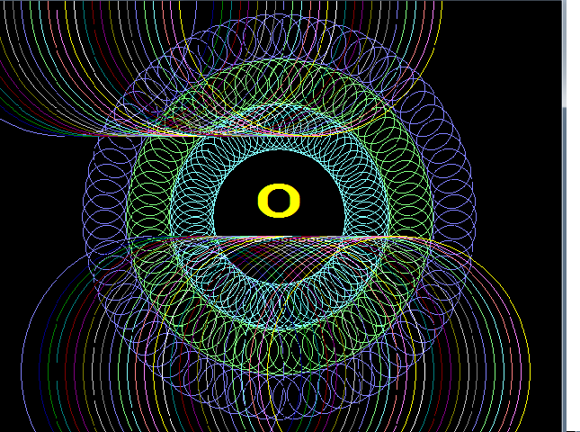
Graphics demo

